Slide 1
Automobile
Price Predictor
With Random Forest
Presenters: Thao H. , May A., Kelvin D., Su Y.
Date: Mar 25th , 2021

Slide 2
Agenda
01
Objective & Motivation
02
Data Transformation
03
Machine Learning Models
04
App Demo & Future Works
2

Slide 3
01
Objective & Motivation
3

Slide 4
Car Expenses
Transport costs generally account for 20 % of after-tax income for a middle-class household in Canada
- Scott Hannah
Car Depreciation
New vehicles shed 10% of their value as soon as you drive them off the lot, and another 10% by the end of the first year.
- D’Arbelles.
Motivation
4

Slide 5

Project Description
Objective
To analyze the depreciation value of cars over the years by analyzing the sale prices on resale posts.
Parameters:
Vehicle Type, Year, Odometer, Fuel Type, Car Condition, Paint Color
Data Source:
Kaggle
Web scrapping every few months on Craiglist

Slide 6
Project Road Map
1
2
Preprocessing
3
Algorithm Selection
Transformation
Check data quality
Onehot Encoding
Standard Scale
Use Pycaret
6
App Deployment
5
4
Model Selection
Final Model
Flask
Html/CSS
Heroku
Refit model with selected features and tuned parameters
Feature Engineering
Hyperparameter Tuning
6

Slide 7
01
Objective & Motivation
02
Data Transformation
7

Slide 8
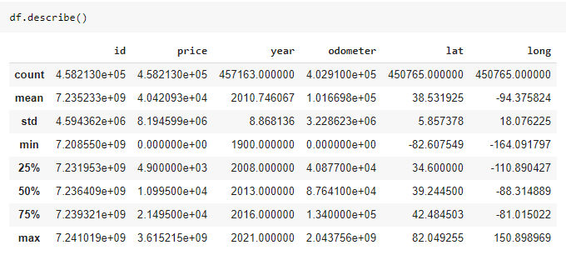
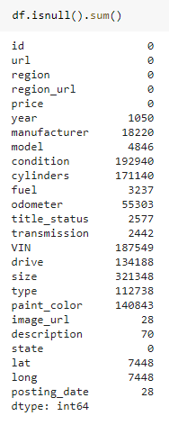
Dataset Quality Check
Invalid inputs (filter)
Price range:
$100 - $200,000
Odometer:
10km – 200,000km
NAN values (drop or replace)
Mean values are in different scales (Standard Scaler)

Slide 9
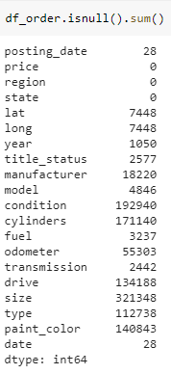
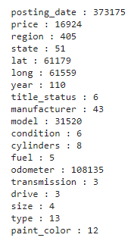
Dataset Transformation
Check unique values
Steps:
1/ Filter out price range and odometer range.
2/ Remove redundant columns.
3/ Check unique values of each column.
Notice: region has 405 unique values and model has 31520 unique values. (increase model complexity)

Slide 10

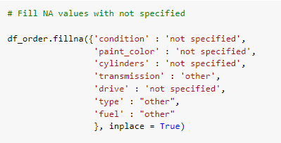
Dataset Transformation
Steps:
4/ Columns in red are important features in determining the price prediction. We drop all rows with NAN values in these columns.
5/ Columns in green, we replaced NAN values with ‘not specified’ or ‘other’ and make it another unique value for each feature. They will be kept in the model.

Slide 11
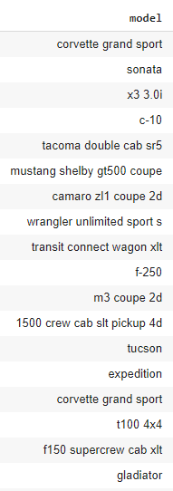



Dataset Transformation
Check unique values
6/ Only take car models that has more than 100 inputs
Reduce complexity of the column by 90x !

Slide 12
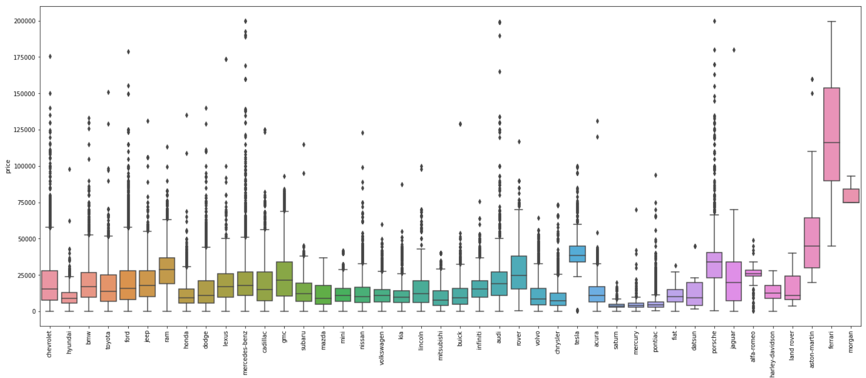
Check Outliers
Price vs. Manufacturer

Slide 13
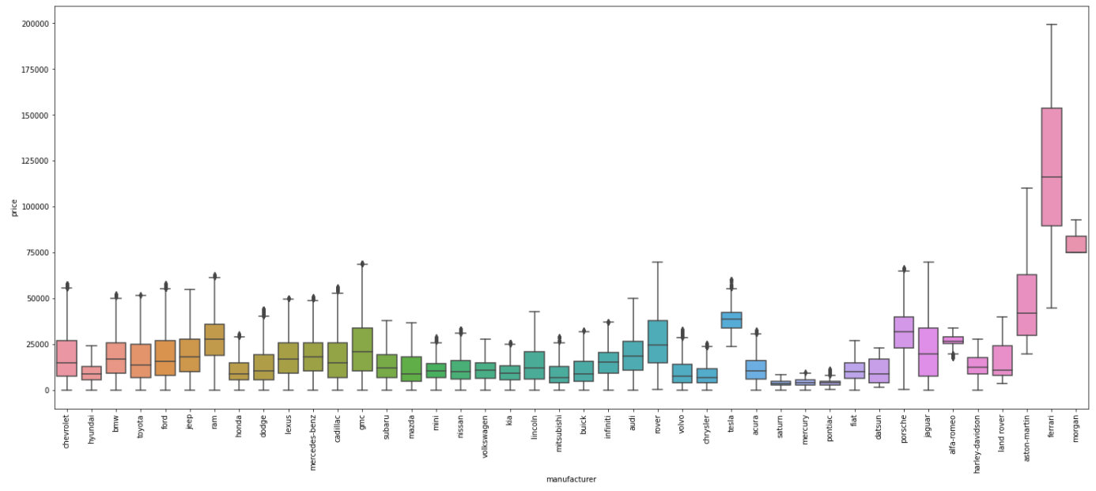
Check Outliers
Price vs. Manufacturer
7/ Remove outliers using interquartile range (IQR)

Slide 14
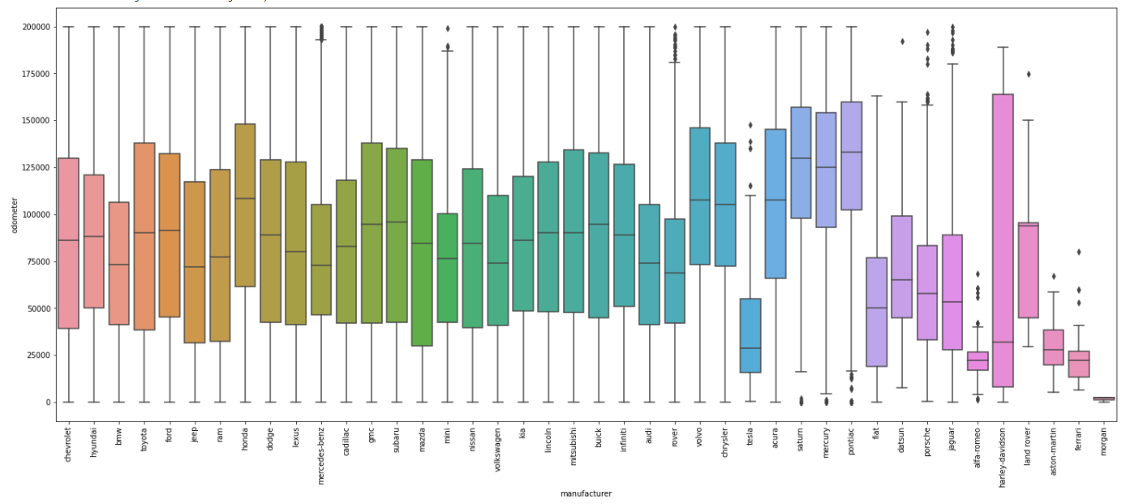
Check Outliers
Odometer vs. Manufacturer

Slide 15
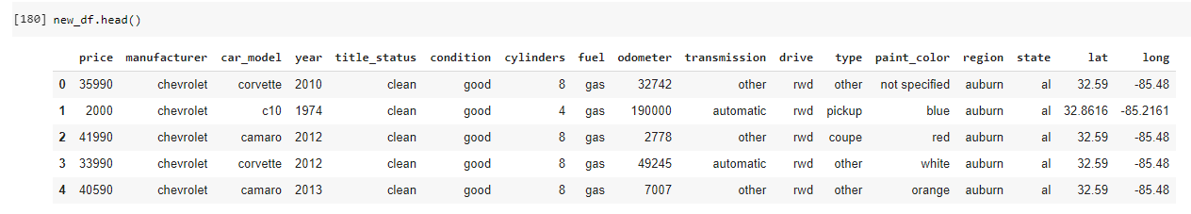
Check Outliers
11 Categorical Features
‘target’
5 Numerical Features

Slide 16
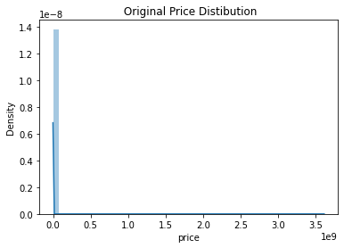
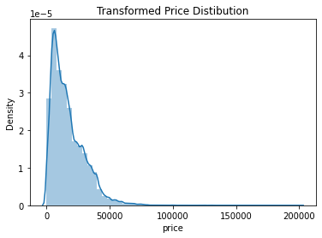
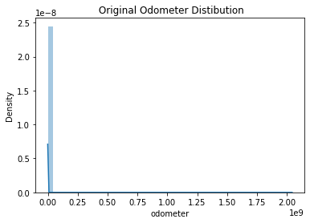
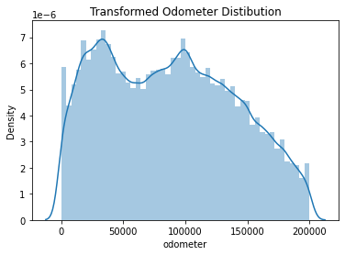
Numerical Features

Slide 17
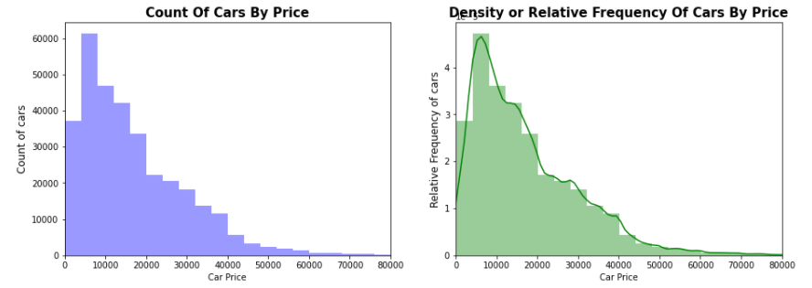
Numerical Features
Majority of cars are prices between $0-$20,000, followed by
$30,000-$40,000 then $40,000+
- More reasonable compared to the original dataset

Slide 18
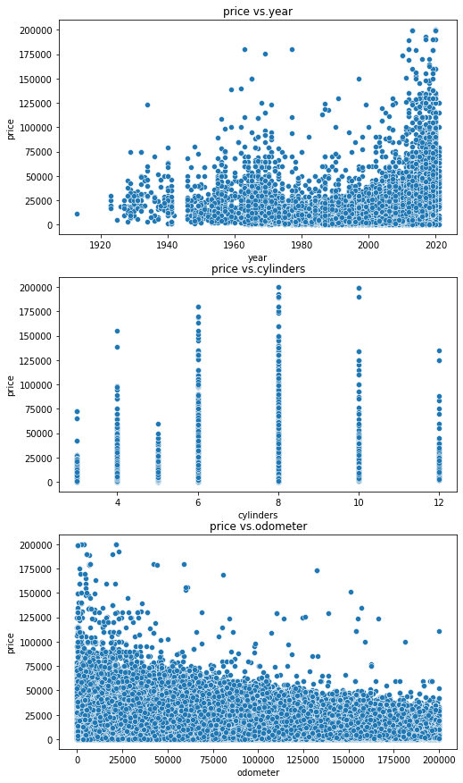
Numerical Features
No linear relation between price and other numerical features.
Do not expect high accuracy with Linear Regression model.

Slide 19
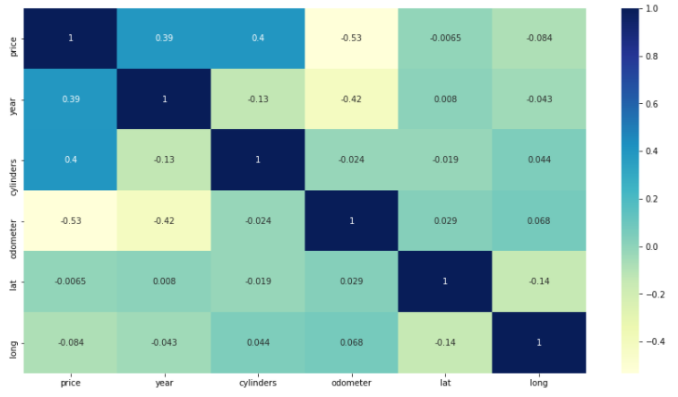
Numerical Features
Price is strongly correlated with Year and Cylinders (higher year and
higher cylinders are priced at higher price)
Cars with higher odometer are priced at lower price.

Slide 20
Categorical Features
11 Categorical Features
‘target’
5 Numerical Features

Slide 21
Feature Engineering
11 Categorical Features
‘target’
351 unique values
Clean, nan
405 unique values
Less impacts on car prices
5 Numerical Features
Again, due to limited computing resources, further drop these columns during data pre-processing step to reduce model complexity.
Reduce from 11 categorical features to 8 features. Get dummies on these remaining features is faster and less computing expensive.

Slide 22
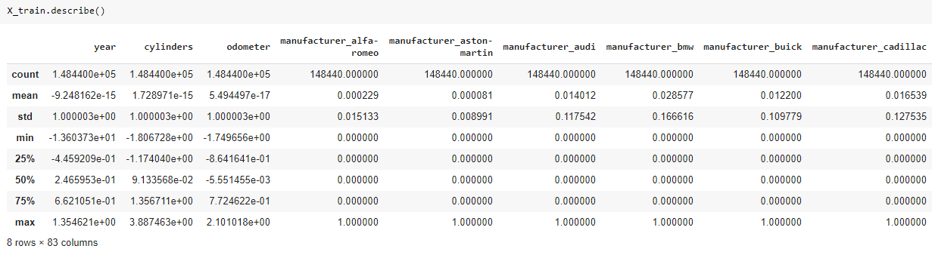
Further Feature Engineering
Apply get_dummies to categorical features
Apply Standard Scaler to numerical features
Split dataset to train (70%) and test (30%)

Slide 23
01
Objective & Motivation
02
Data Transformation
03
Machine Learning Models
23

Slide 24
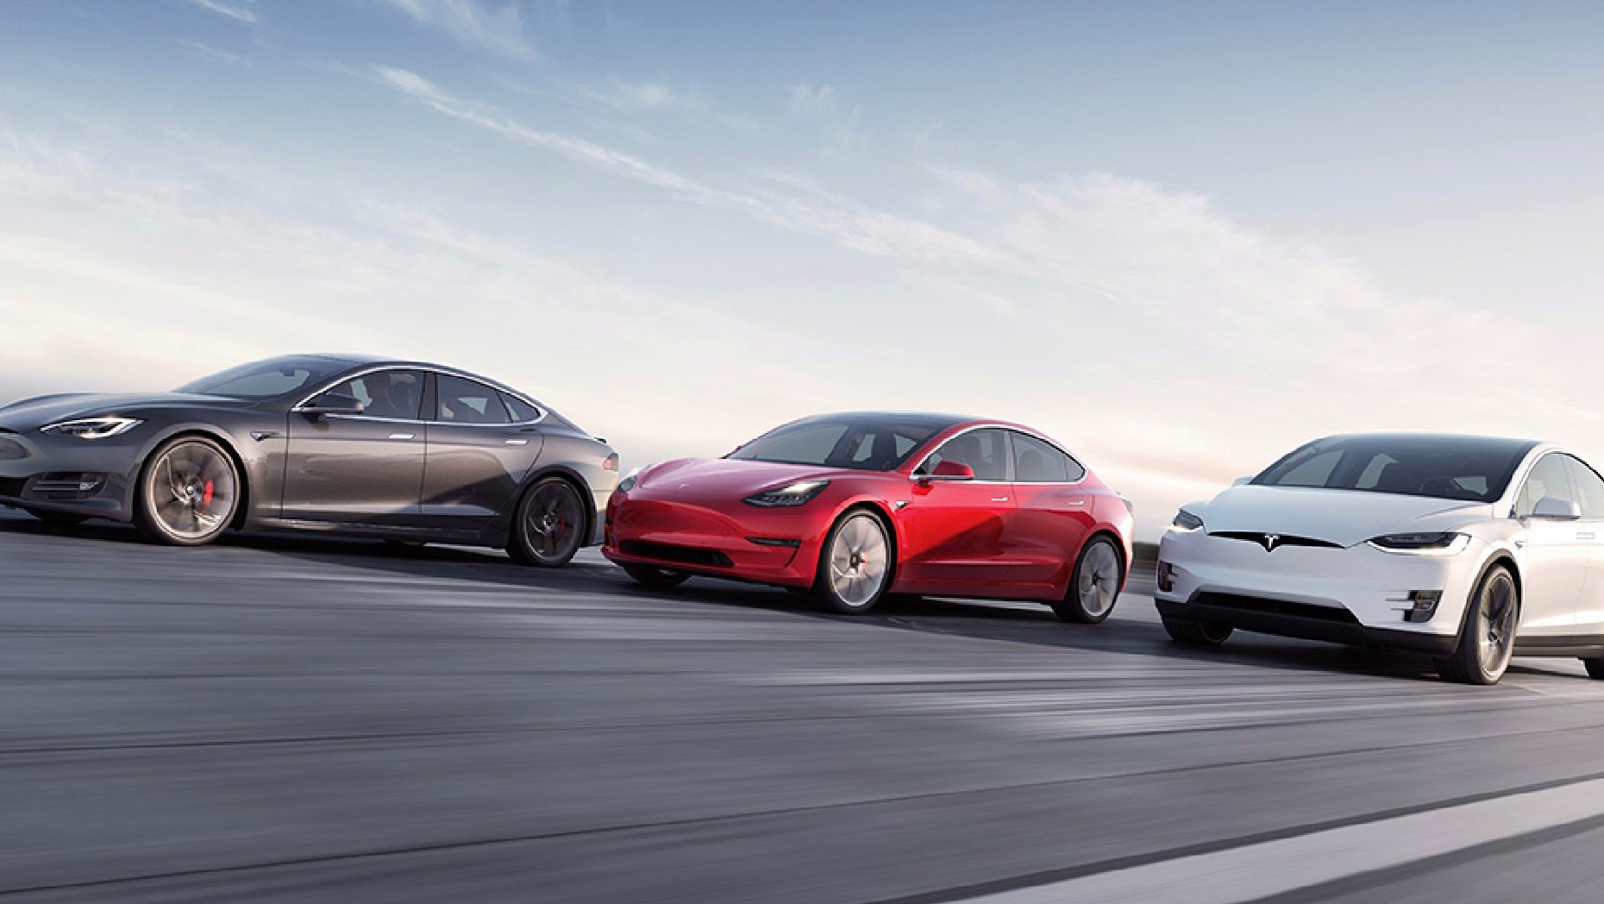
Algorithms Comparison
(Pycaret)

Slide 25
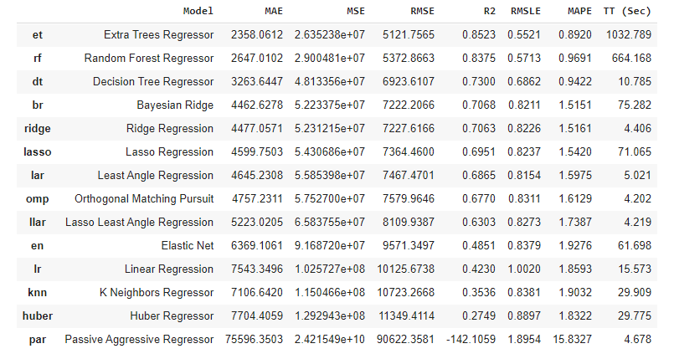
Regression Analysis with Pycaret
With limited computing resources that Colab allows, we only used 30% of the data set to run the model comparison function.
By default, Pycaret automatically split 30% of data for testing, and uses k-fold validation with k = 10.
Based on the results, we can expect that Random Forest Regressor will be a better fit than Linear Regression for our model.

Slide 26
Model
Selection
Linear Regression
Random Forest Regression
26

Slide 27
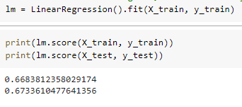
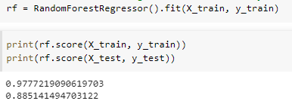
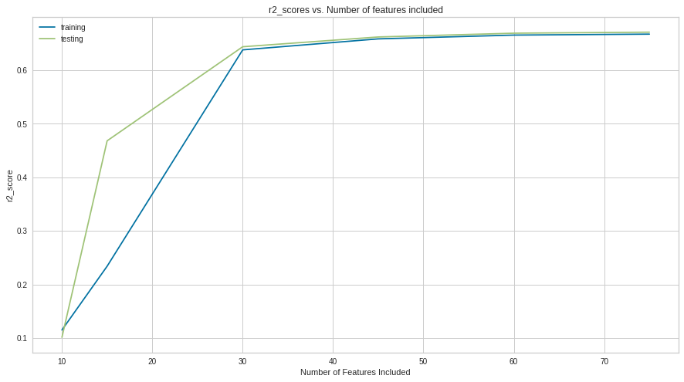
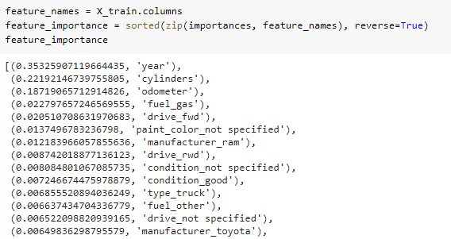
Multi-Linear Regression vs Random Forest Regression
30-40 features to capture 65% of data variance
7 features to capture 85% of data variance

Slide 28
Final Model
Random Forest Regression
With Hyperparameters Tuning
28

Slide 29
Final Model Inputs
Remaining: 200,000 + Records
Result:
Data Sets | RFE | Time to train | Results | Train Score/ Test Score
100% | Yes | 4 hrs+ | Not enough computing resources | N/A
30% | Yes | 3 hrs+ | Not enough computing resources | N/A
100% | No | 45 mins | 787 MB | 97% / 89%
20% (42k rows) | No | 15 mins | 192 MB, after compressed 37MB w/ gzip | 96% / 83%

Slide 30
01
Objective & Motivation
02
Data Transformation
03
Machine Learning Models
04
App Demo & Future Works
30

Slide 31


App Demo
http://vehicle-price.herokuapp.com/

Slide 32
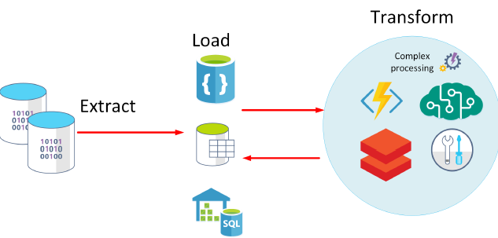
Future Work
When computing resources available, add back ‘model’ column to increase prediction accuracy
Further Feature Engineering Tasks to reduce the model complexity while maintaining accuracy
Perform ELT: load big datafile onto Data Base and use cloud resources to query and perform transformation and load back clean data sets. Right now we are using Google Drive.

Slide 33
THANK YOU
Any Questions?

